Slide 1
Insemi System

Slide 2
Screen 1: Login
USERNAME:
PASSWORD:
CAPTCHA
SUBMIT

Slide 3
Screen 2: HOMIE SCREEN
Welcome Arup Sir,
SCREEN
+
Notification Cards
Enter TimeTracker
Export Files
(Non-Permanent)
Calendar

Slide 4
Screen 3: Time Tracker
TIME TRACKER
00:00
Choose Your Action:
Additional Comments
STOP
Save as Draft
Submit for Approval

Slide 5
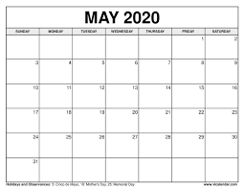
Screen 4: Calendar
Daily Report
Activity 1
8:00 AM – 9:00PM
Activity 2
10:00 PM – 7 AM

Slide 6
Screen 5: Export Files
Select Report
.xlsx
.docx
.pdf
.txt
.csv
.xml
Export As
Notes:
Add TimeTracker functionality

Slide 7
Screen 6: Data Analysis
76% Attendance
82% Predicted
67% Prediction for Tomorrow

